Slide 1

SATELLITE ANTENNA
TRACKING SYSTEM
ECEN 403-902
Sponsor: David Gent
TA: Pranav Dhulipala
Team: David Santos, Michael Raabe, Hunter Britton
Photo from Pexels.com by @InstaWalli

Slide 2
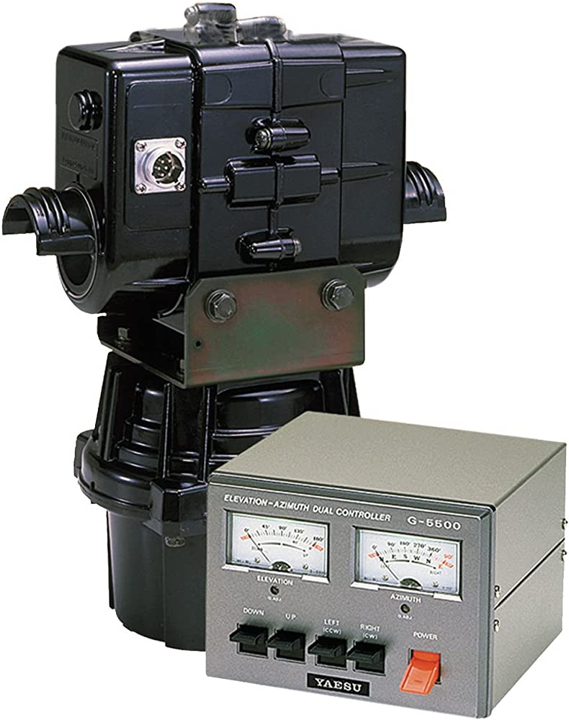
Executive Summary
Problem Statement
Amateur radio enthusiast need remote access
Current systems use outdated proprietary software/expensive hardware
Our Solution
Additional Hardware + Web Interface
Flexible, Collaborative, and Inexpensive
Yaesu G-5500 Rotator
Source: Amazon.com

Slide 3


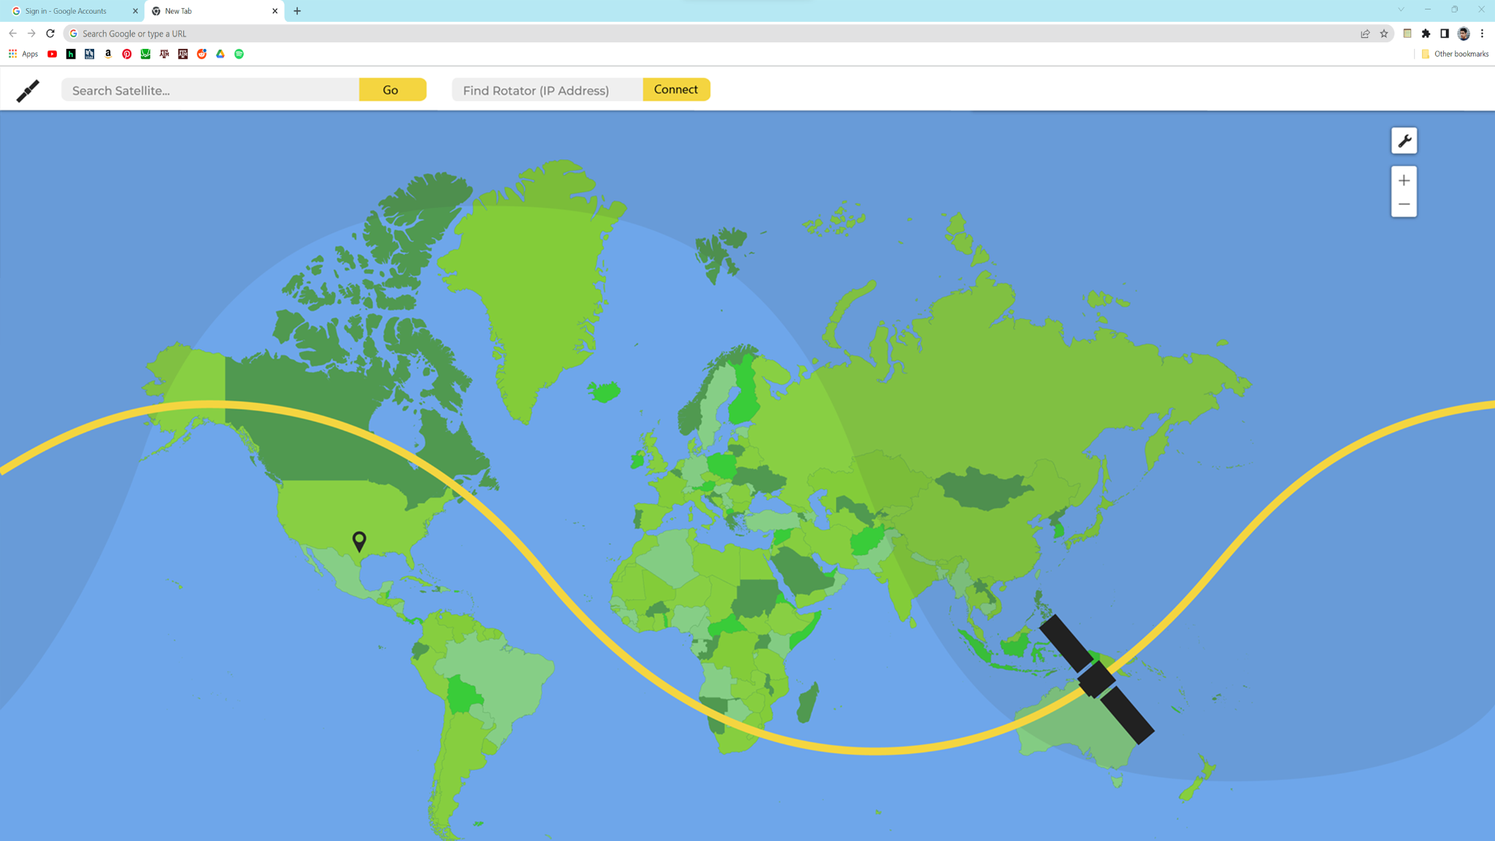
Cloud Platform
Photo generated with Stable Diffusion

Slide 4
System Overview
SDR
Web App
User Interface
Real-Time Database
Cloud Functions
Wifi Port
Antenna Array
Rotator
Custom PCB
Microcontroller/IO
Elevation Motor
Motor Driver
Display
Wifi
Azimuth
Motor
PSU
MCU
GPS
Legacy
Michael Raabe
Hunter Britton
David Santos

Slide 5
Microcontroller - Hunter Britton
MCU/IO
Display
WIFI
Orbital Dynamics Algorithm: Keplerian to Azi(t) and Elv(t)
I/O (i.e. LED display, GPS)
Motor Control: Feedback Logic
Position
OMM Download
Status
Loc/Pos
Upload
MCU
I/O
Motor Signal
GPS

Slide 6
Power Supply/Motor Driver - Michael Raabe
Custom PCB
Motor Driver
Power Input: 110VAC Wall Outlet
Power Supply PCB with 2 outputs
Power for Motor Driver
Power for Microcontroller Subsystem
L298N 2A
PSU
Motor Driver Out: 24 VDC/2A
110 VAC
Input
Microcontroller
Out: 9 VDC/200 mA

Slide 7
Web Application - David Santos
Web App
UI
Database
User Control Interface
Rotator Communication
Satellite Search/Orbital Data
Interactive Map
Satellite Selection
Firebase
Mode Control
Wifi Port
Cloud Functions
Orbit Retrieval
Sensor Data Capture

Slide 8

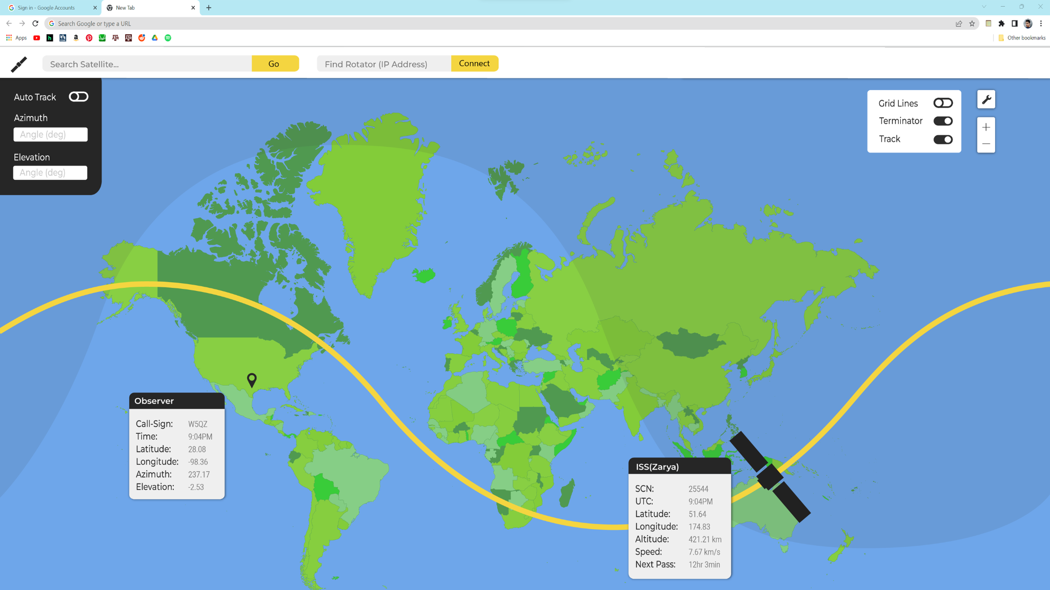

Slide 9
Execution Plan
Subsystem | Feb 27 | March 6 | March 20 | April 3 | April 17
Web App | UI Feature Finalization | Wifi Port/ MCU Connect | Search/OMM Retrieval | Interactive Map | UI Data Visualization
PSU/Motor | Finish Overall PSU Design | Finish PSU/Motor Driver Schematic |  | Perfboard and Test Design
MCU | MCU connects to Wifi |  | LCD displays output | Finish Kepelarian math | MCU output signal for motor control

Slide 10
Validation Plan
Test | Criteria | Method | Owner
Signal | SNR >= 30dB | Built-In Signal and Noise measurements in SDR Interface | All
RST | R5 S5 T9 | Request report from one-to-one interaction | All
Accuracy | +- 4% | Rotary Potentiometer Positioning Sensors | All
Tracking Speed | 2 deg/second | Rotary Potentiometer Positioning Sensors/ MCU timer | All
Motor Supply | 48 Watts minimum | Multimeter/ Ammeter | Michael R
MCU Supply | 1.8 Watts minimum | Multimeter/ Ammeter | Michael R
GPS Location | +- 20 meters | Actual Position coordinates vs GPs coordinates | Hunter B
MCU/Web App Communication | Data Request/Read/Write | Firebase Console logging data | Hunter B/ David S
Web App Ironclad | Functional Search Bar/Control/Map | buttons (pass/fail), console logging data, interactive map feature test | David S

